Slide 1
C++ Developer for SAP HANA Workload Intelligence Team
Nguyen Khac Thai
Seoul Nation University
2018.08.01
Notes:
Good afternoon, my name is Thai, I am from VN. I am currently a graduate from SNU.
It is my great honor to be here today with a short presentation explaining why I am applying for SAP.

Slide 2
Content
Introduction
Why do I apply for SAP?
Toward scalability
Modern C++
My master thesis
Personal values
Notes:
This is the structure of my talk. First, I will talk in more details about myself. Next, I will go through main reasons why I like to work for SAP
After that, I will touch on toward scalability and Mordern C++ which is my great interest. Finally I will introduce my research over the past few years before mentioning some of my personal values.

Slide 3
Introduction
About myself
Education
M.Sc, Electrical and Computer Engineering, Seoul National University
B.S, Electronics, Hanoi University Of Science and Technology
Experience
Almost 2 years in Samsung Vietnam Mobile R&D Center
What I am confident in
Background on Data structure and Algorithm
Modern C++ skills
Analytical and Structural thinking
Familiar with Linux and Git environment
What I need to learn for the job
Database and SAP platform knowledge

Slide 4
Why do I apply for SAP?
Interested in challenging problems in SAP
Cache-efficiency optimization
High concurrency data structure
Latch-free techniques
Interested in highly-optimized, careful-drafted code
C++ is excellent for the task
Admired of German working style
Reliable, perfectionist, organized
International working environment

Slide 5
Toward scalability
The basics: For every function wrote:
Know the big O
Time and space complexity
Analyze the worst case
Optimization using BUD analysis
B: bottleneck
U: Unnecessary work
D: Duplicate work
Know the coding efficiency and security
What is the runtime of API functions?
Pass by value or reference?
Is it const, inline or noexcept?
Can they be generalized to templates?
If it is an interface, how could it evolve in the future?
Changing interface specs may break users’ code

Slide 6
Toward scalability
Why I find problems in SAP challenging?
When I prepare for Google interview, the big O of an algorithm is very important.
In SAP, other aspects are important as well:
Cache-efficiency is an important optimization
Cache-aware indexing structures
More optimization for data structure
Latch-free and cache-friendly data structure
Prefetching and other techniques to optimize runtime and space

Slide 7
Modern C++
What I love about modern C++
Powerful tools to control performance
Move semantics
Low-level control (memory, compilation)
Better resource control
Resource handler
Smart pointer
Well support for both OOD and generic programming
Better for OOD than C
Better for generic programming than Java
More comfortable for coding
Auto
Lambda
Variadic function
Notes:
Control:
Inline
Virtual function
Meta programming

Slide 8
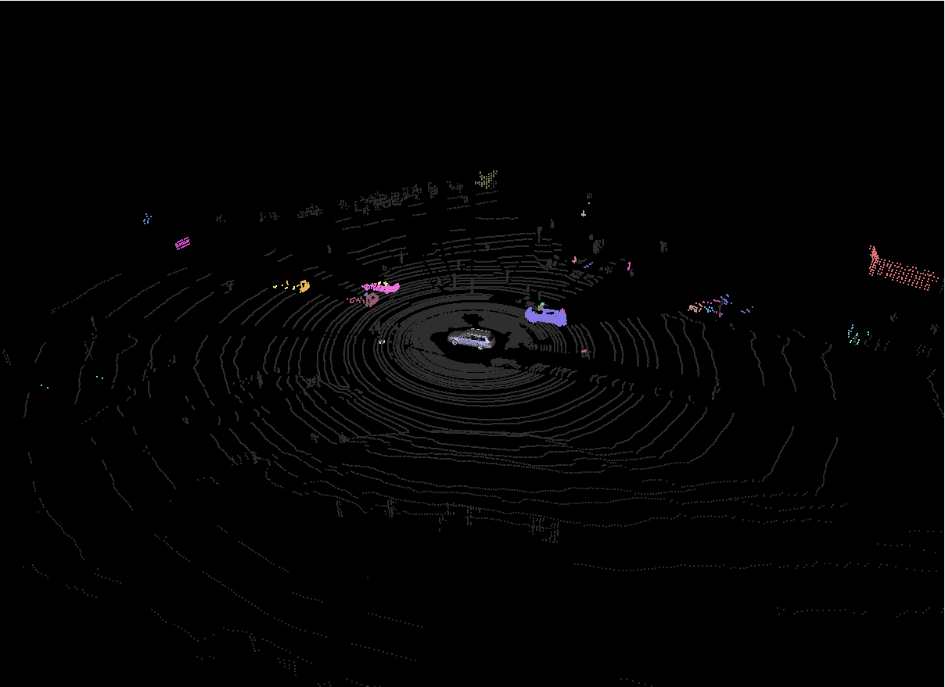
My master thesis
Moving object detection
Detect moving object using LiDAR sensor for autonomous driving
No camera is used in this task
Object detection in 3D data

Slide 9
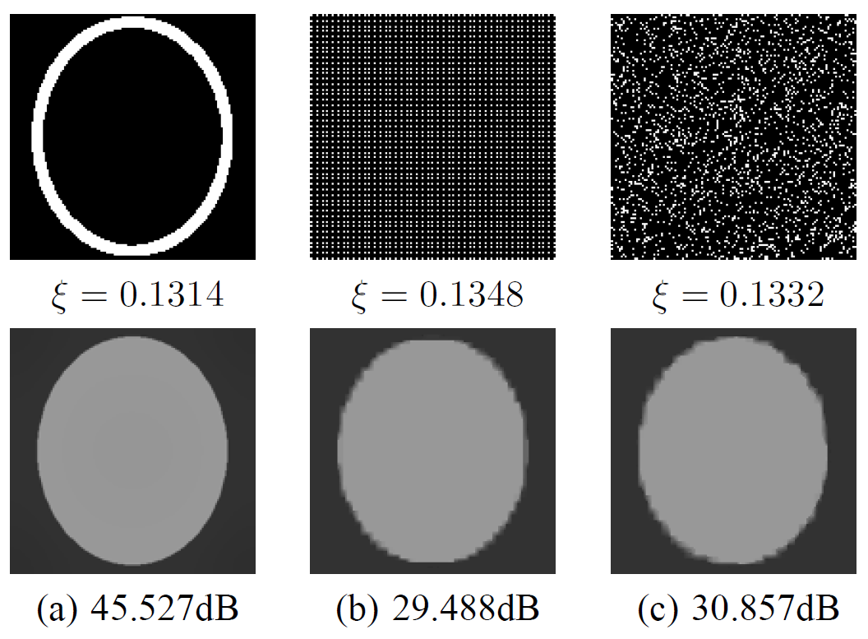
My master thesis
LiDAR sampling for autonomous driving
LiDAR sampling rate is low
Lead to the problem of sampling to increase the efficiency
My approach using object detection to enhance sampling technique
Gradient-based sampling (a) compared to grid sampling (b) and random sampling (c)

Slide 10
Personal values
Commitment
Reliable
Sensible
Constant learning
Notes:
Commitment: I get involved well in a team and put the team’s mission/goal as my priority and do my best for it
Reliable: I don’t like to put things off and try to keep everything worked as its schedule
Sensible: I try to be productive by balancing my life and my work so that I can develop myself most.
Constant learning: I love reading books regarding my field, for example in my free time I do self-learning in order to keep myself updated

Slide 11
Thank you for your attention

